Slide 1


Slide 2
Fall Prevention Month is a campaign that encourages organizations and individuals to come together to coordinate fall prevention efforts for a larger impact.
Use the resources on the website to raise awareness of fall prevention in your community.
Launched November 2015
Notes:
The Fall Prevention Month website includes evidence-based resources to help organizations successfully organize fall prevention initiatives for November.

Slide 3
Contributors and Friends of
Fall Prevention Month
The Fall Prevention Month Partners want to thank the following organizations who have actively contributed to the development of the Fall Prevention Month campaign with their time, knowledge and skills.
Click here to see the list
Notes:
Contributors are organizations that actively support and promote the Fall Prevention Month campaign and related initiatives within their networks.
Friends of Fall Prevention Month are private sector organizations that actively promote the campaign and related initiatives within their networks.

Slide 4
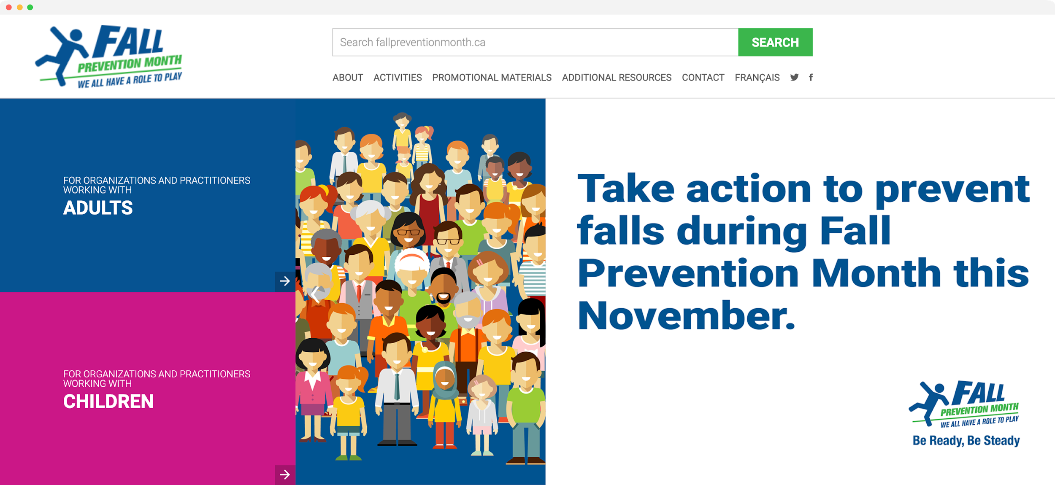
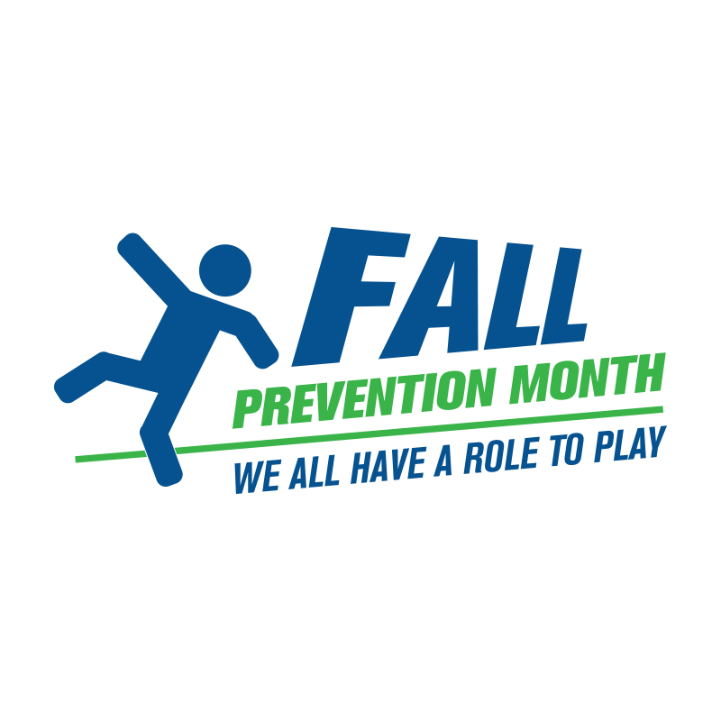
Fall Prevention Month Website
www.fallpreventionmonth.ca
French resources and events are available on the French section of the website.
Notes:
This is the home page for the website.

Slide 5


Bilingual Website
Activities
Ideas to help you plan and host your own activity or event
Promotional Materials
Resources to help you promote the campaign or your activity/event
Additional Resources
Materials developed by external organizations with information on a variety of related topics
www.fallpreventionmonth.ca
www.novembresanschute.ca
Twitter:
@FallPreventCA
#PreventFallsCA
#FallPreventionMonthCA
#PreventiondesChutes
Facebook:
@FallPreventionMonth
#PreventFallsCA
#FallPreventionMonthCA
#PreventiondesChutes
Notes:
The website is bilingual. It features promotional materials, activity ideas, additional resources, current and archived newsletters and connects to the social media handles.

Slide 6
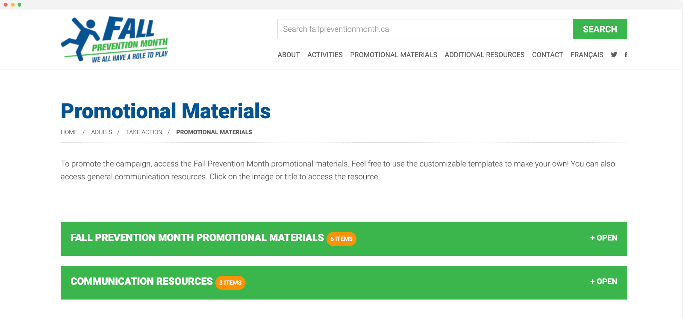
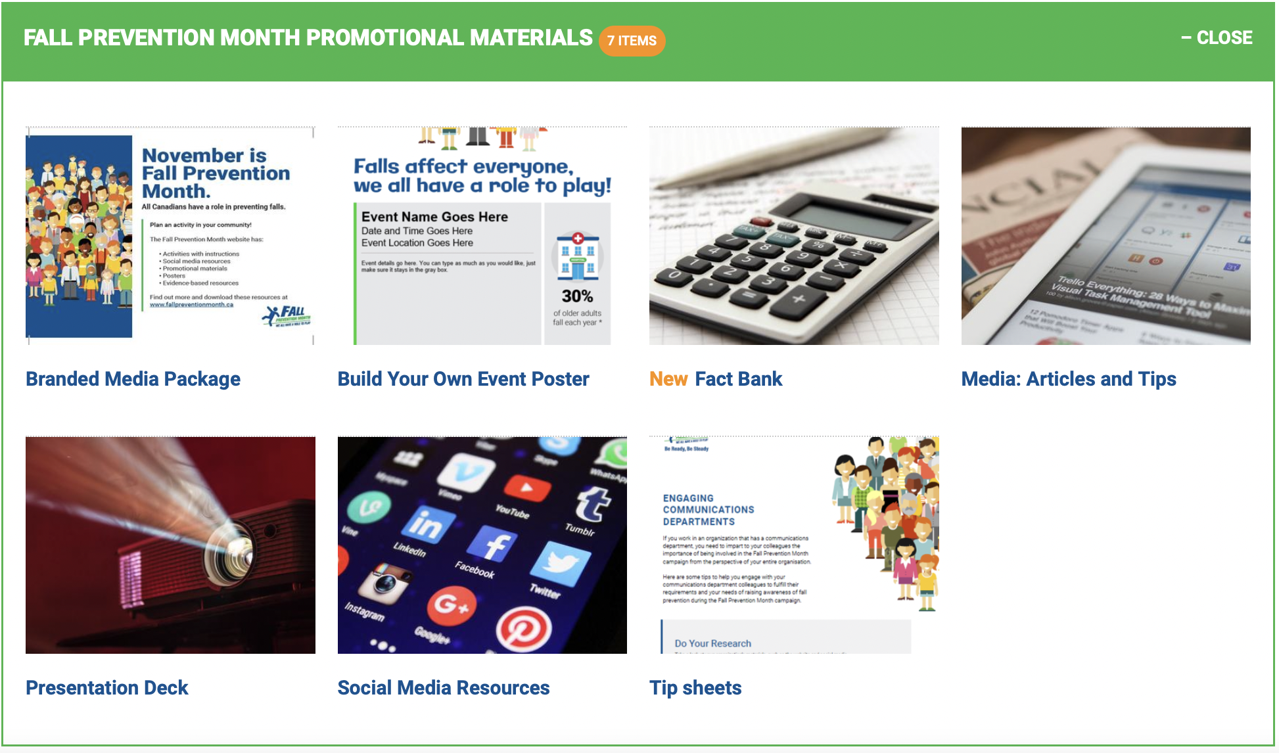
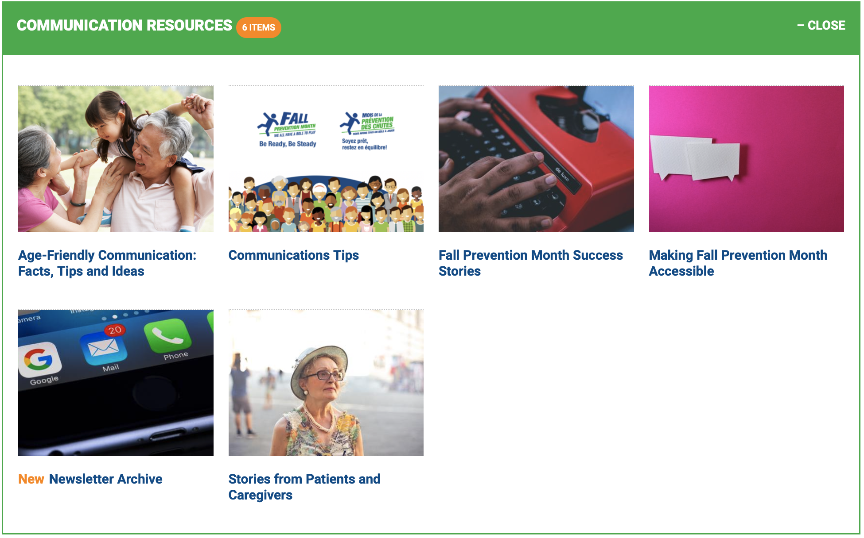
Promotional Materials
www.fallpreventionmonth.ca
Notes:
Promotional materials are resources to help you promote the campaign or your activity/event

Slide 7
Promotional Materials Available
Promotional Materials | C | Communication Resources
Branded Media Package |  | Age-Friendly Communication: Facts, Tips and Ideas
Build Your Own Event Poster
 |  | Fall Prevention Month Success Stories
Fact Bank (Updated)
 |  | Stories from Patients & Caregivers
Media Articles & Tips (Updated)
 |  | E-newsletter Archive (Updated)
Social Media Resources (Updated) |  | Making Fall Prevention Month Accessible
Tip Sheets |  | Communication Tips
These resources may change as new ones become available.

Slide 8
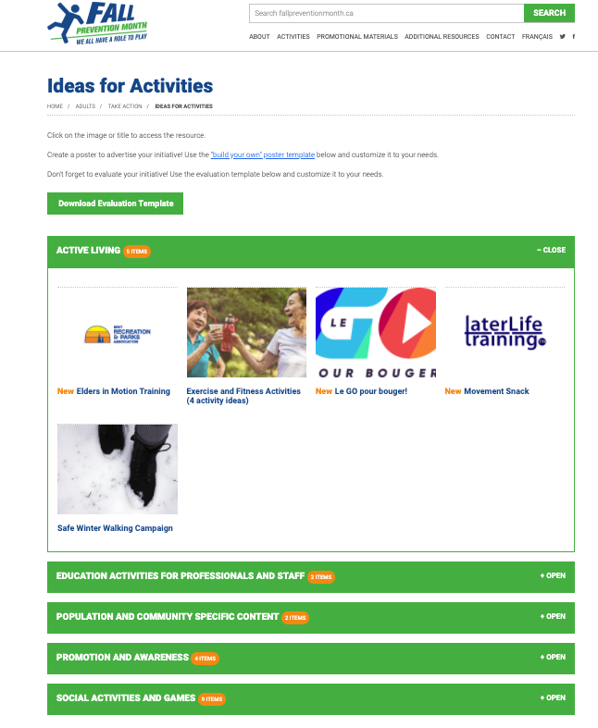
Activities You Can Host for Adults
Notes:
The Fall Prevention Month is a call to action for all communities across Canada to raise awareness of fall prevention in older adults and children in their respective organizations/communities.
One of the best ways we encourage organizations to take action is by hosting events/activities to promote fall prevention. Check out the grab and go activities in the activities tab.

Slide 9
Activities You Can Host for Adults
In-person and virtual activities your organization can organize and/or plan with partners
Instructions and downloads available
Examples:
Virtual |  | In Person
Falls Assistant Online Games |  | Fall Prevention Month Display
Elders in Motion Training |  | Fall Risk Factor Visual Brainstorming Activity
Public Education Presentation
Movement Snack
… and more!
Notes:
A few examples of virtual and in-person activities. These activities are aimed at preventing falls among adults and older adults.

Slide 10
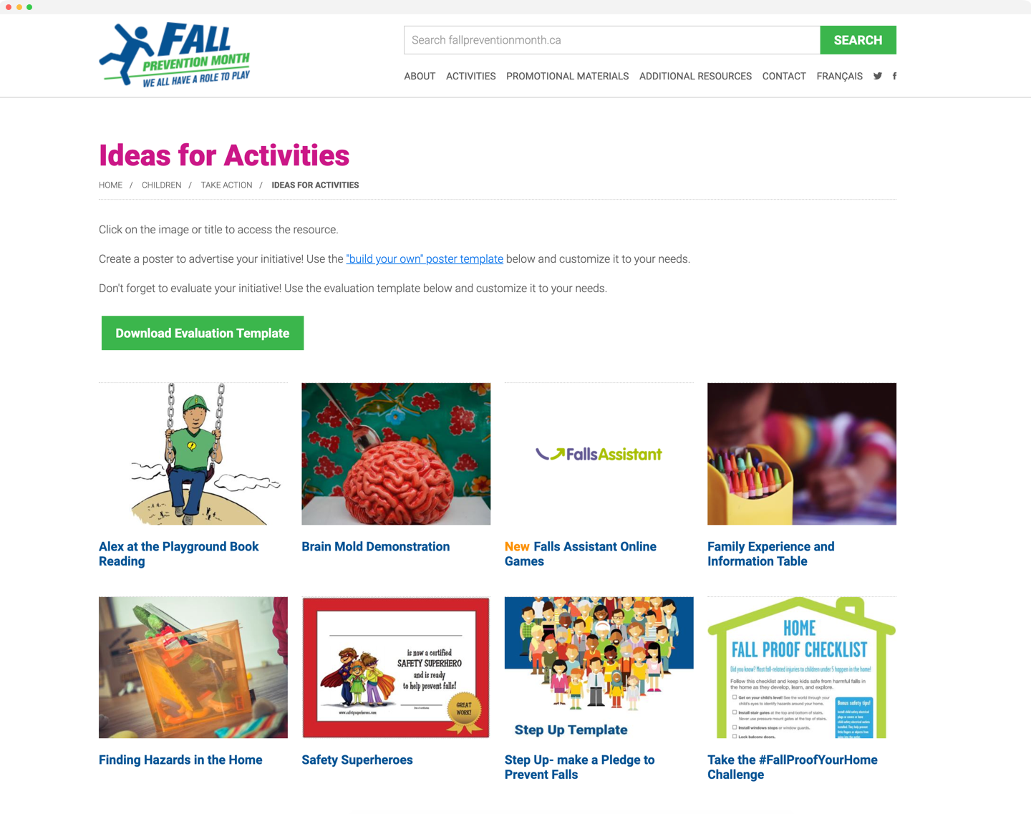
Activities You Can Host
for Children
Notes:
The Fall Prevention Month is a call to action for all communities across Canada to raise awareness of fall prevention in older adults and children in their respective organizations/communities.
One of the best ways we encourage organizations to take action is by hosting events/activities to promote fall prevention. Check out the grab and go activities in the activities tab.

Slide 11
Activities You Can Host
for Children
In-person and virtual activities your organization can organize and/or plan with partners
Instructions and downloads available
Examples:
Virtual |  | In Person
Safety Superheroes |  | #FallProofYourHome Challenge
Alex at the Playground Book Reading |  | Brain Mold Demonstration
Step Up
Family Experience and Information Table
… and more!
Notes:
A few examples of virtual and in-person activities. These activities are aimed at preventing falls in children.

Slide 12
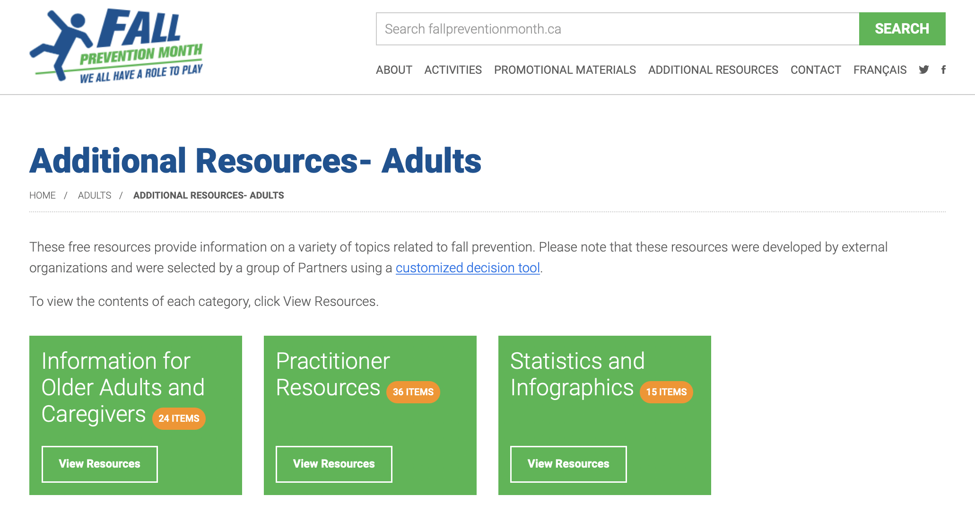
Additional Resources - Adults
Notes:
Here’s an example of additional resources for adults. The additional resources are free materials developed by external organizations that provide information on a variety of topics related to fall prevention and can include practitioner resources, statistics and infographics, along with information for older adults and caregivers.

Slide 13
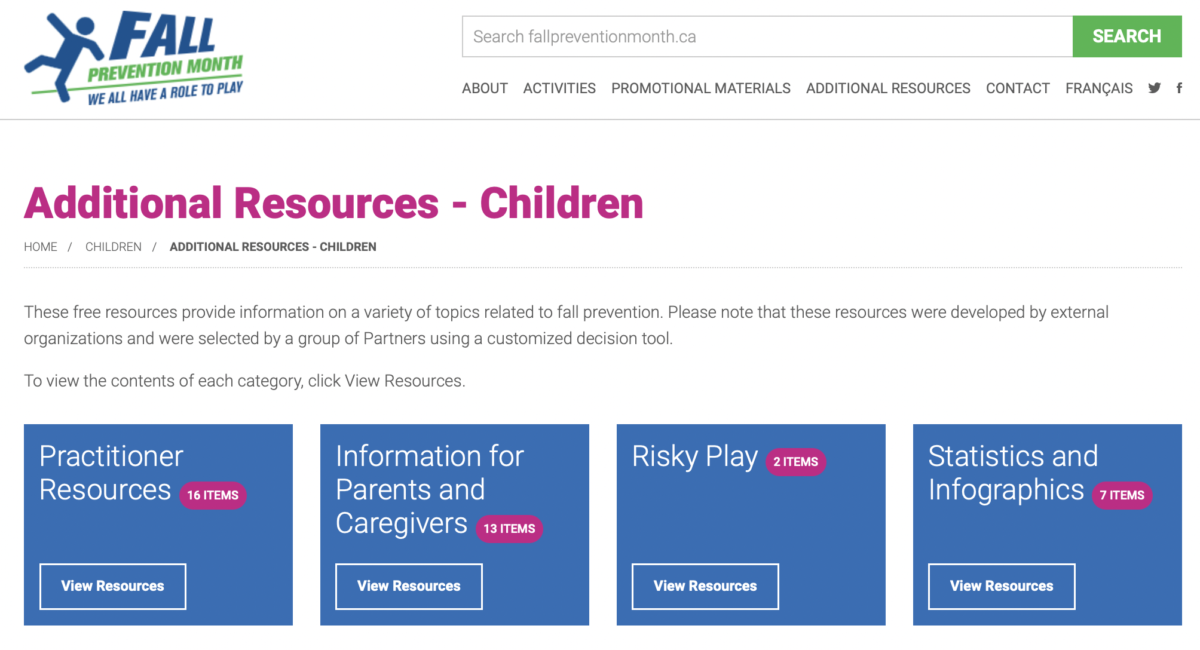
Additional Resources - Children
Notes:
Here’s an example of additional resources for children. The additional resources are free materials developed by external organizations that provide information on a variety of topics related to fall prevention and can include practitioner resources, statistics and infographics, along with information for parents and caregivers.

Slide 14



Thank you!
Have a question about Fall Prevention Month?
Michelle Dueckman, Coordinator, Knowledge Translation and Programs
Parachute
mdueckman@parachute.ca
@FallPreventionMonth
@fallpreventCA
#PreventFallsCA
#FallPreventionMonthCA
#PreventiondesChutes

Slide 15
Thank you!
[PRESENTERS CONTACT INFO]
[NAME]
[TITLE, ORGANIZATION]
[EMAIL]
@FallPreventionMonth
@fallpreventCA
#
#PreventFallsCA
#FallPreventionMonthCA
#PreventiondesChutes

